Slide 1
A Glimpse into Data Science in Industry NCSSM Data Science Summer Institute Summer Research Programs July 14, 2023 Dr. Rachel Levy (Ray) Executive Director, NC State Data Science Academy

Slide 2
Data science: turning information into insight

Slide 3
Let’s start with a game.
With your neighbors, come up with three places your students might work in the future. (you have about 2 minutes)
Next, l will call on some groups to suggest a place.
Then I’ll share some ways that data science plays a role in that workplace.

Slide 4
Take home message: Every workplace has data.

Slide 5
More and more, workplaces…
Want to collect the data they need to gain insight.
Hire people who use data to make predictions or decisions.
Need to manage their data (organization, security, privacy).
Consider sharing their data so it can be more useful.
Incorporate the use of data into their budget and strategy.

Slide 6
Connecting with Industry has been a recurring theme in my career…

Slide 7
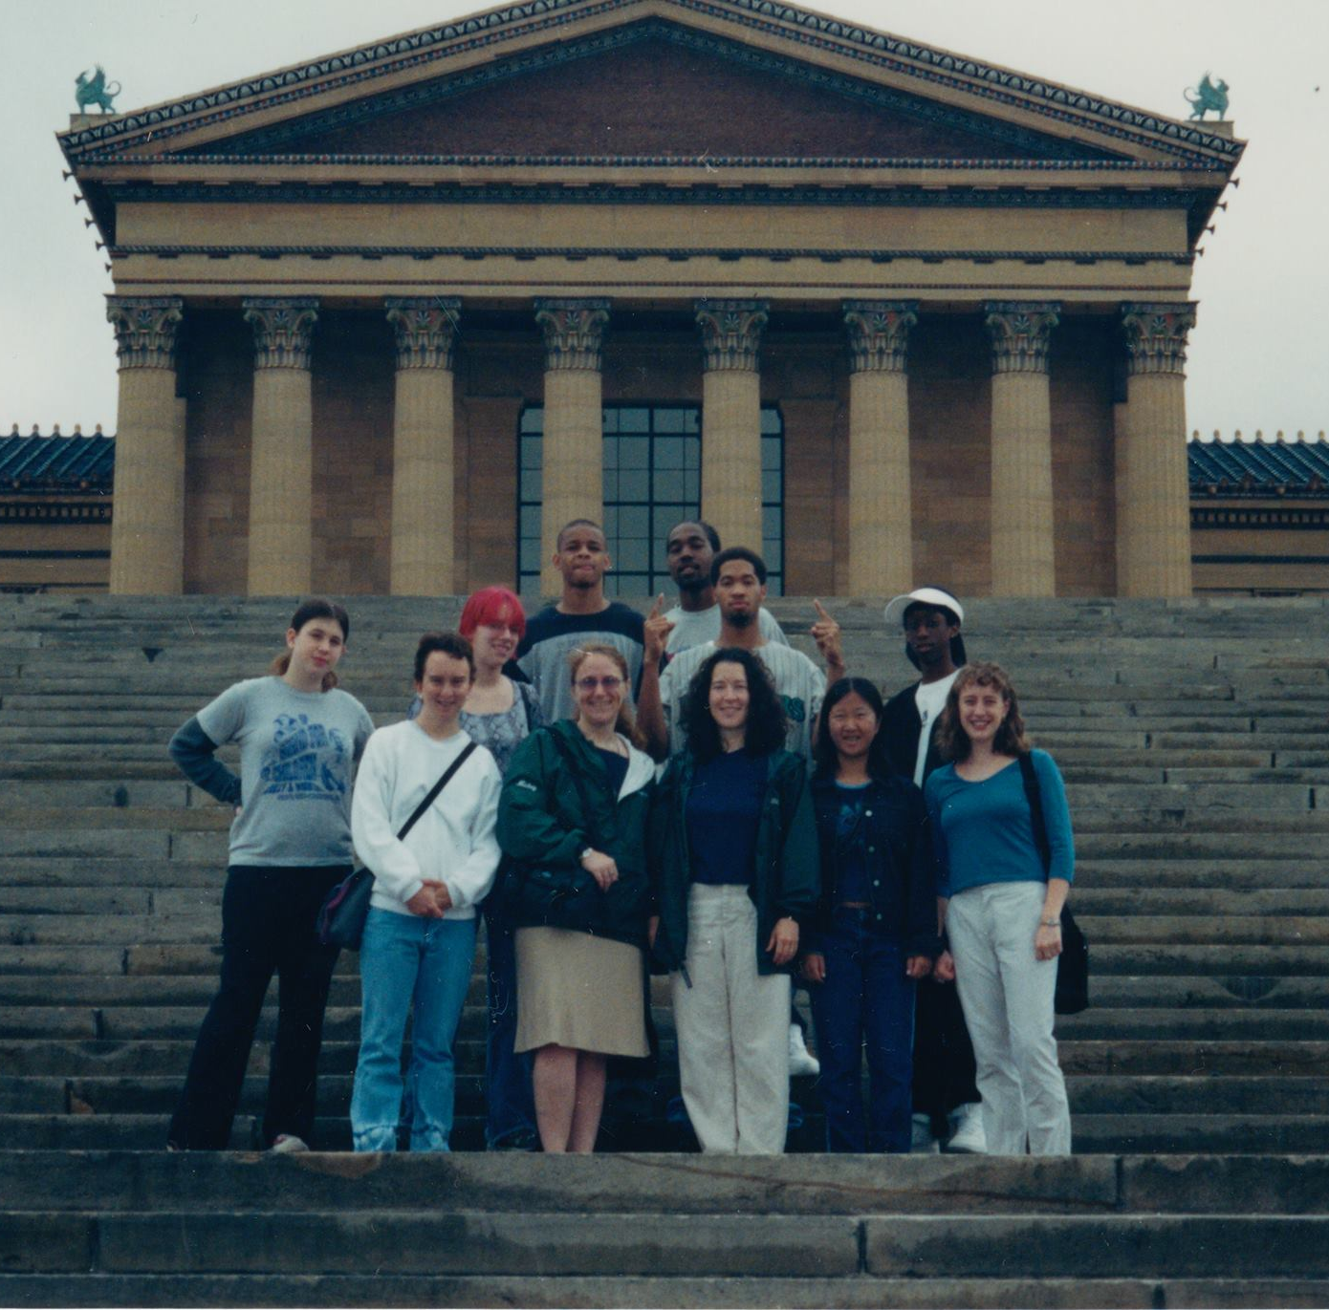
Carolina Friends School – 4 yrs MS 4 yrs HS + Dean
1990’s – how can new tools like graphing calculators allow us to teach math by asking questions, exploring concepts and assessing learning in new ways?
Fast forward: same questions for data science.

Slide 8
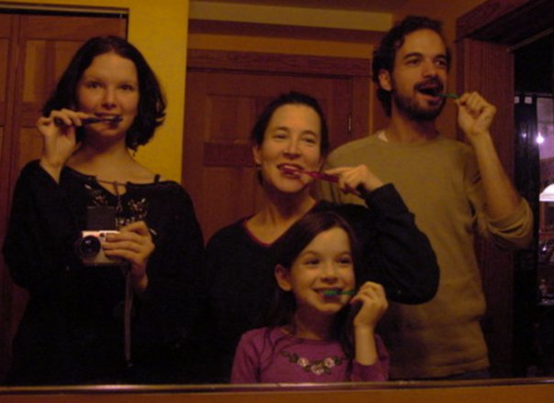

Slide 9
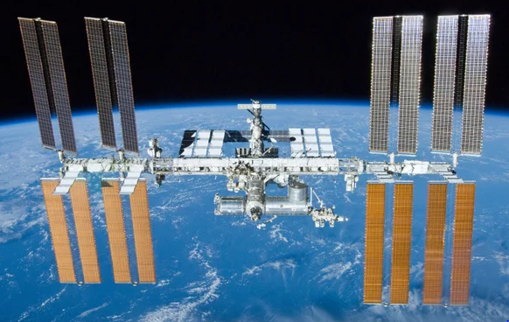
I had a Master’s Degree in Educational Media and Instructional Design and 2 kids. Why get a MS & PhD in Applied Math? The credentials opened many doors.
Student research experience at NASA put the idea in my head to learn more…

Slide 10

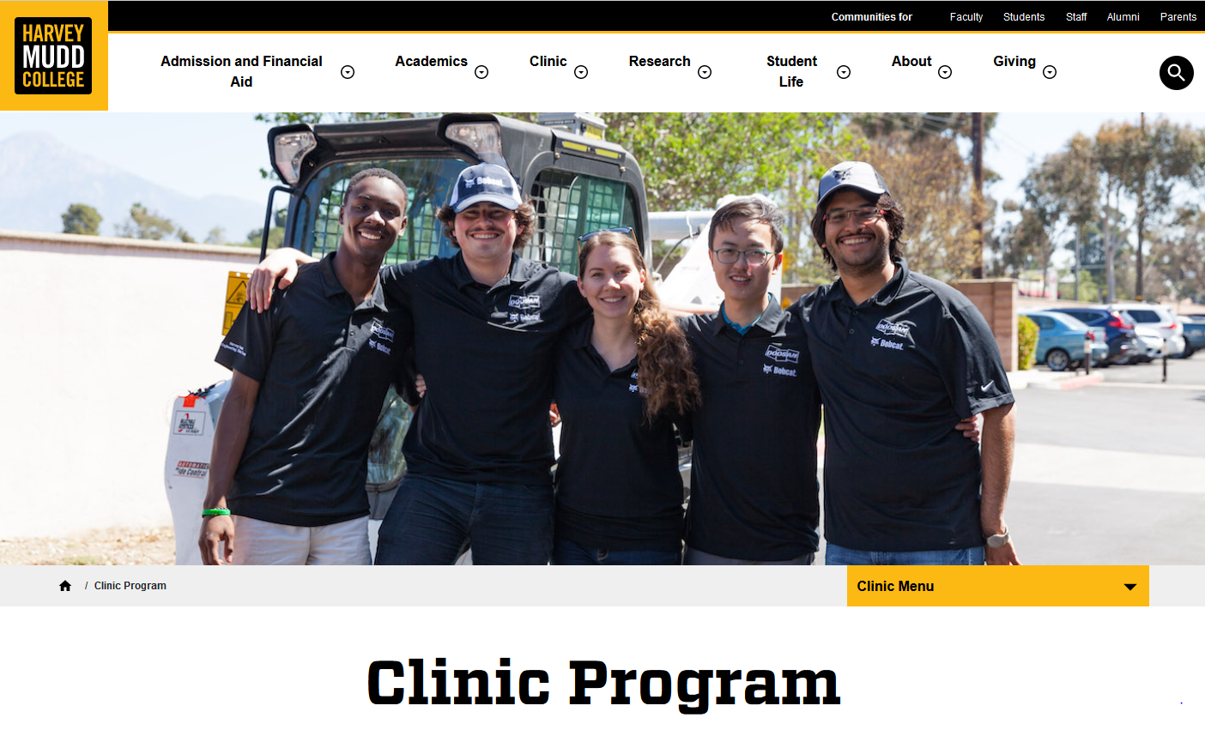
Harvey Mudd College – prof for 12 years and Associate Dean for Faculty Development

Slide 11




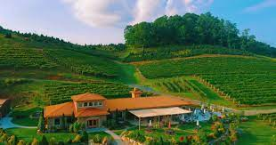
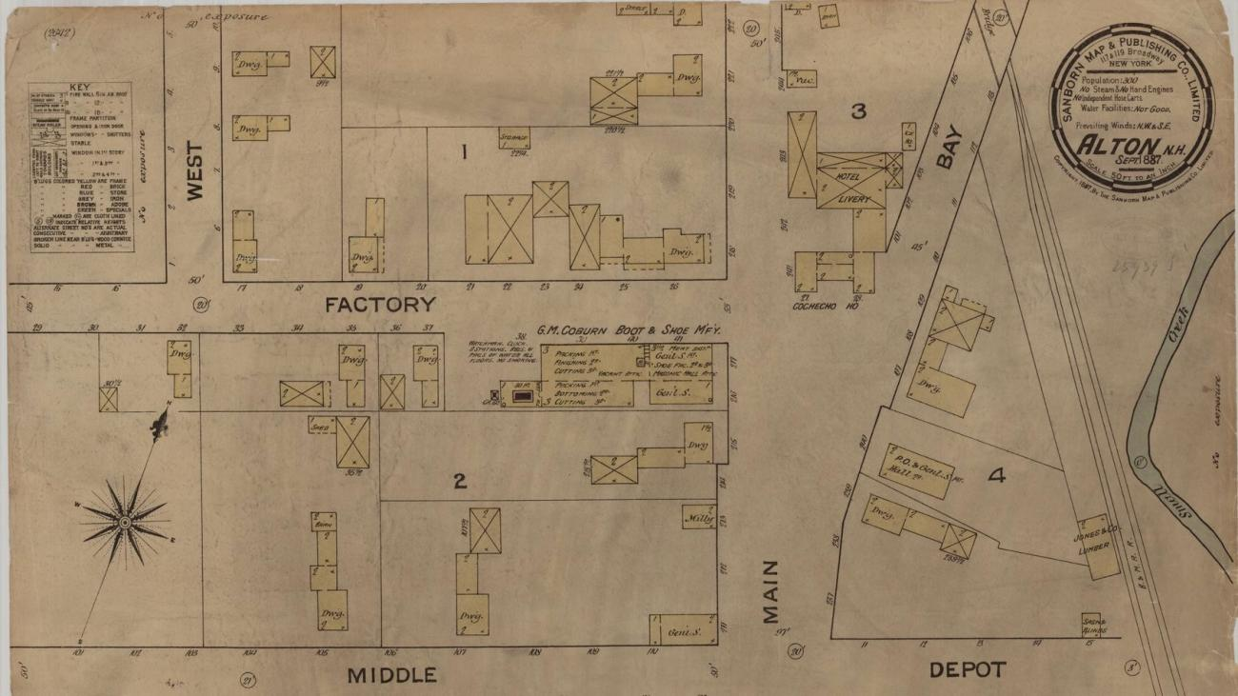
Student Clinic Projects at Harvey Mudd College

Slide 12
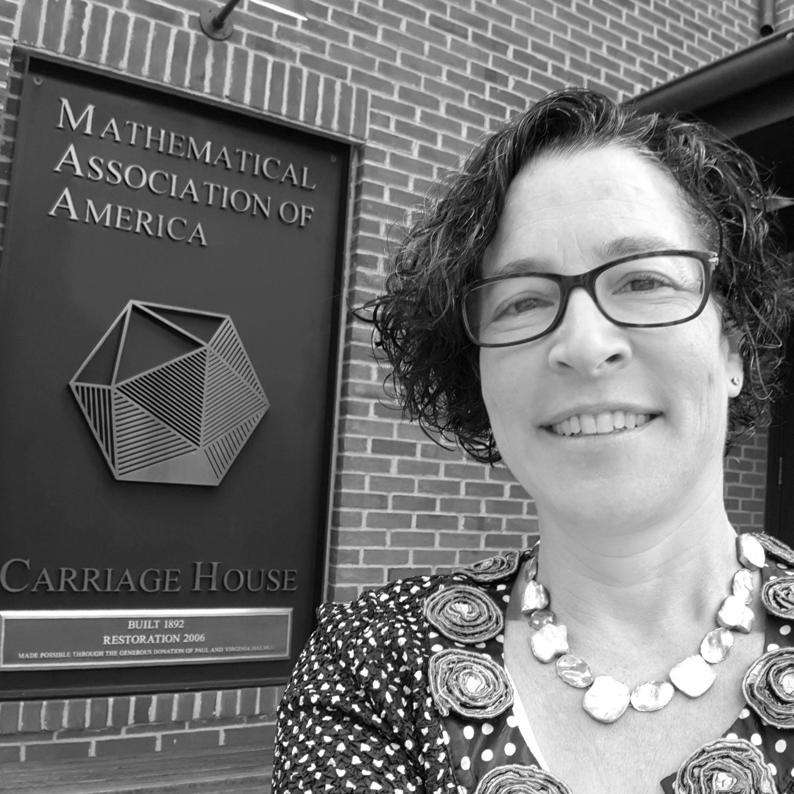
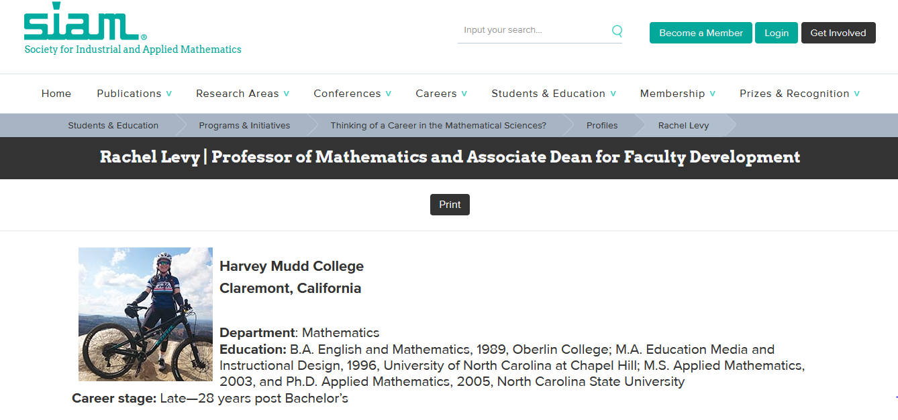
Non-profits: Professional Societies
Vice President for Education Deputy Executive Director

Slide 13
Non-profit data challenges
Who can we recruit as members/participants?
How can we prioritize work/expenditures?
How can we demonstrate impact?
How can we identify potential donors / funding?

Slide 14
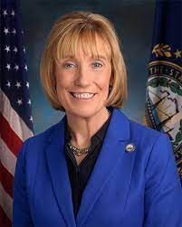
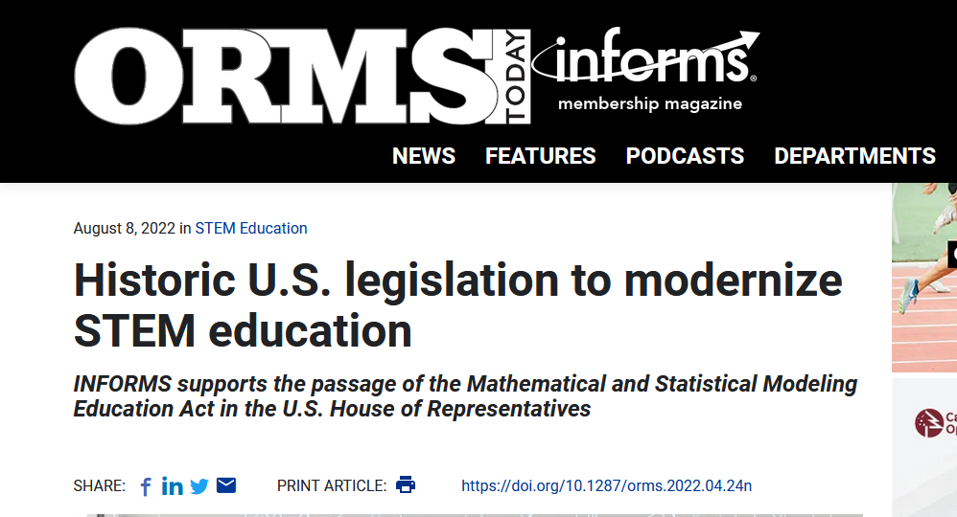
Government: AAAS Policy Fellow for US Senator Maggie Hassan – New Hampshire

Slide 15
Government data challenges
Data from many sources – how to gather and combine
Large systems that need updating but could break if you only change one part
Estimating the cost of proposed legislation (and arguing why it should or should not pass)
Data security, privacy, sharing as well as modeling

Slide 16
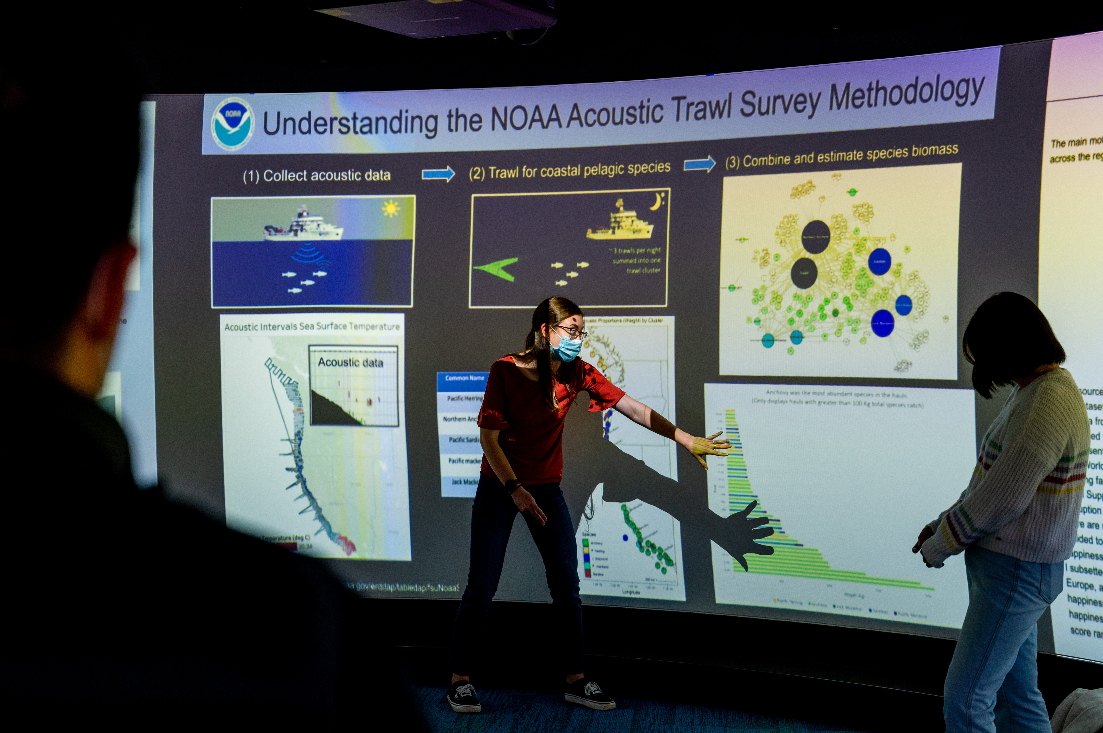
The NC State Data Science Academy Data Science for everyone.
At the NC State University Data Science Academy we are
making good on the promise of Data Science for Everyone
through our ADAPT course design principles.

Slide 17
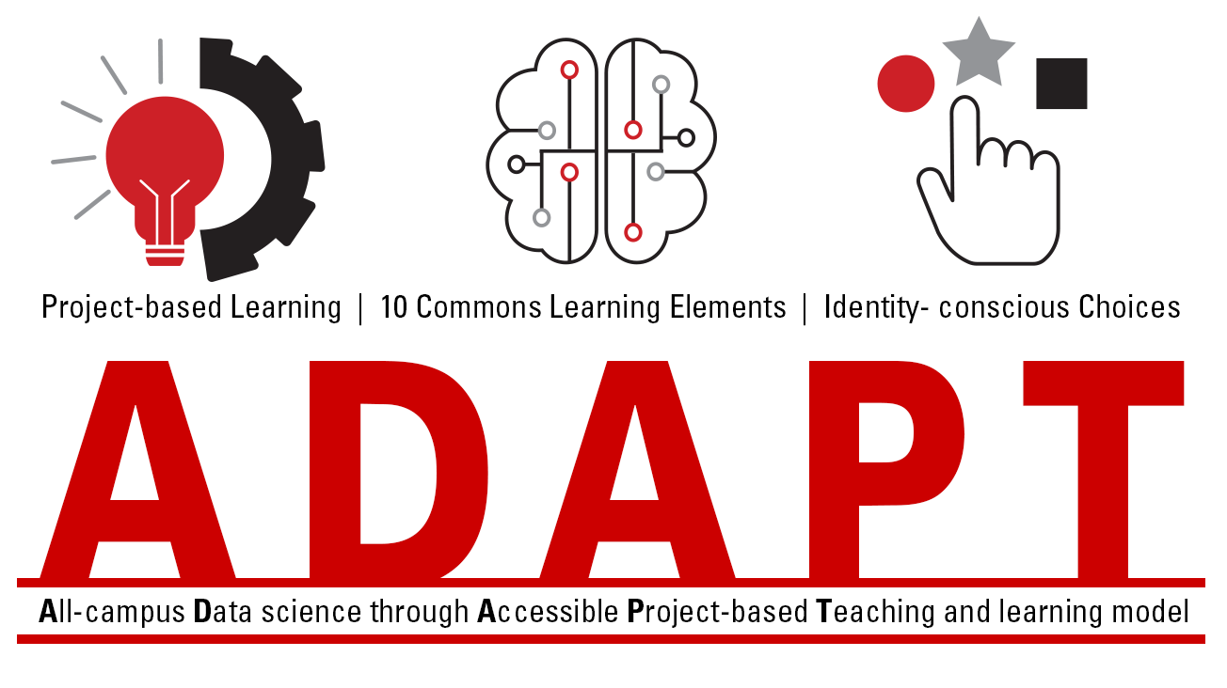

Slide 18
We invite you to test the ADAPT model and contribute to its development!
You can pick just one idea
Let us know you are trying it
Report how it goes
We are happy to provide support and encouragement

Slide 19
Project-based teaching and learning
No quizzes, tests or exams
Homework and projects
1-credit courses
Workshop model (like writing workshop)

Slide 20
10 Common Learning Elements
Data Perspectives
Recognizing data as information - not truth - with error, variability, and degrees of inclusion/exclusion,
Explaining what it means to be a data scientist and data-enabled,
Observing a diverse collection of data scientist role models and careers,

Slide 21
10 Common Learning Elements
Data Practices
Examining how data are created, and the related assumptions and collection practices,
Practicing data curation, wrangling, and cleaning,
Assessing validity of data, methods, results, and communication,
Employing accessibility practices (e.g., alt text, color choices, GUIs, sonification, visualization, commenting, captioning),
Investigating ethical issues and ways to approach them,

Slide 22
10 Common Learning Elements
Data Discoveries
Articulating current issues or open questions in data science, and
Specifying exciting discoveries or impacts of data science.

Slide 23
Identity-conscious choices
Context of the project
Data set
Which question to ask about a large data set
Which tool to use
Who/what the solution is optimized to help
How to communicate solutions

Slide 24
In 2 years 800 units delivered
24 sections scheduled for Fall 2023
Over 100 majors participated
All 10 colleges of the university
Undergraduates, graduate students, faculty, staff as learners
Demographics similar to that of university

Slide 25
The Data Science Academy courses include mathematical and statistical modeling data science artificial intelligence… How are these topics related and different?

Slide 26
Let’s start with mathematical and statistical modeling data science artificial intelligence

Slide 27
Many modelers have favorite models of modeling. (Do you?) Here’s a simple one.
Objective (hypothesis, question)
Constraints
Data
Model
Solution
Check: is it a useful solution? Iterate as necessary.

Slide 28
Let’s discuss this modeling question: How much toilet paper should I buy?

Slide 29
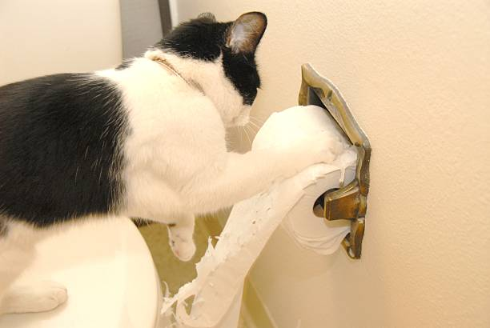

How much toilet paper should I buy? Answer: It depends on the CONTEXT.
Why am I buying toilet paper? For whom?
Does it matter what kind of toilet paper I buy?
How much money do I have?
How much storage room do I have?
How much do I need?
How does the price change if I buy more?
Which is worse, to buy too little or too much?
Do I need a flexible answer that works for different situations?
https://www.gettyimages.com/photos/funny-toilet-paper

Slide 30
Simple model for toilet paper purchasing
Objective – not run out.
Constraints – budget, space, time for shopping.
Data – seems like we use about 1 roll every 5 days (unless grandkids are visiting in which case it is one roll per waking hour) and we go shopping once a week, pack I buy has 12 rolls.
Model – 5 days/roll * 12 rolls/pack = 60 days/pack 60 days/pack * 1 month / 30 days = 2 months/pack
Solution - buy 1 pack every other month. Keep an extra pack as backup at all times. Test/Check: is it a useful solution?

Slide 31
Modeling question: How much toilet paper should I buy? Key point: it depends on who the answer serves
Who will use the answer? For what purpose?
How general does the solution have to be? Are you answering for 1 client/person or creating a recommendation system that can work for anyone?
How certain is this answer? We expect 80 guests +/- 5 guests.
Is the answer a range? I sleep 7-10 hours a night.
Is this kind of modeling part of data science? Short answer: yes.

Slide 32
In the workplace, there’s always a client (or multiple stakeholders) and objective(s)
The answer might be a range of numbers
The answer might have uncertainty (uncertainty quantification is a huge field)
The answer might need to be flexible – circumstances change
Modular solutions might have re-useable parts

Slide 33
Now let’s consider mathematical and statistical modeling data science artificial intelligence

Slide 34

Data Science
turns info into insight
Royalty-free stock vector ID: 422456077

Slide 35
Many kinds of data
Data Science
turns info into insight
words
sounds
numbers
smells/tastes
images
sensor data
Royalty-free stock vector ID: 422456077

Slide 36
Many approaches
Data Science
turns info into insight
Statistics
Artificial Intelligence
Math Modeling
Data cleaning and wrangling
Image Processing
Natural Language Processing
Operations Research
Data (viz) communication
Royalty-free stock vector ID: 422456077

Slide 37
Many tools (these are examples)
Data Science
turns info into insight
SAS/JMP
R and RStudio
Power BI
Python and notebooks
Kubernetes
KNIME
Tableau
SQL
Excel
Royalty-free stock vector ID: 422456077

Slide 38
Many job titles
Data Science
turns info into insight
Data analyst
Data scientist
Data engineer
Cybersecurity
Marketing/Communication
Clinical trials
Data support
Business intelligence
Royalty-free stock vector ID: 422456077

Slide 39
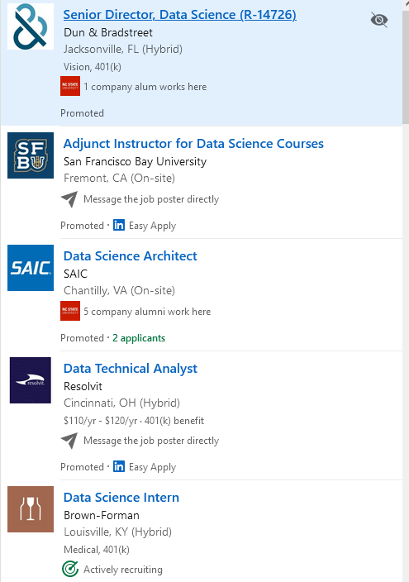
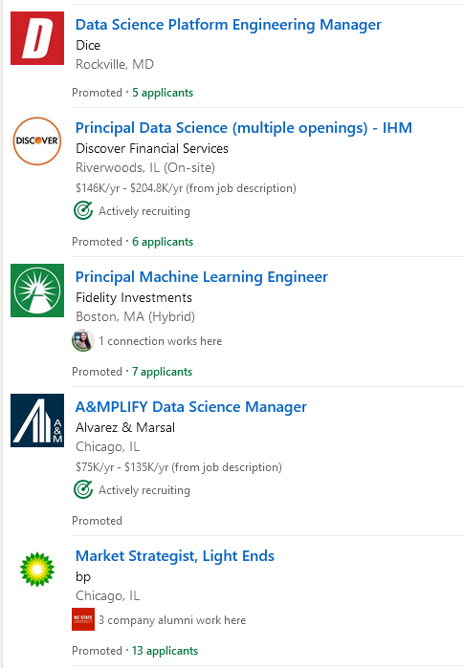
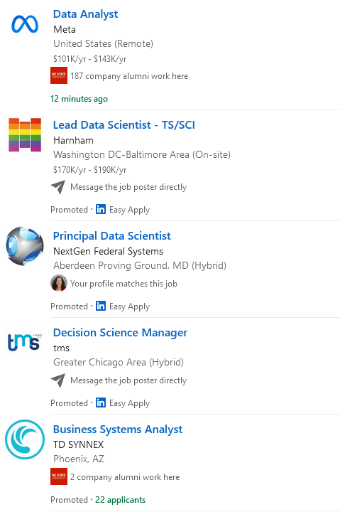

Slide 40
What do employers want?
Technical and people skills
T-shaped applicants (breadth and depth)
Experiences in addition to coursework
Being able to explain how you as an individual have brought value to a team and organization
NOT everything on the wish list in the job ad (but some things with evidence to back it up)

Slide 41
Let’s dig a little more into mathematical and statistical modeling data science artificial intelligence

Slide 42
What do you think of when you hear the words “Artificial Intelligence (AI)”?

Slide 43
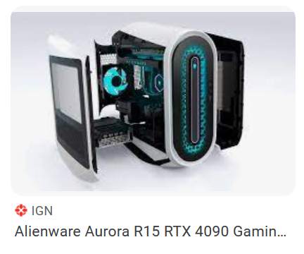
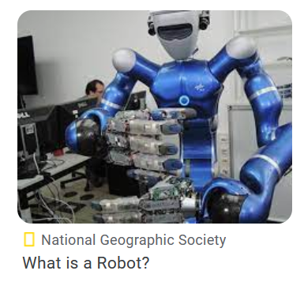
What do you think of when you hear the words “Artificial Intelligence (AI)”?
computer
robot?
tech?
machine?

Slide 44
What do you think of when you hear the words “Artificial Intelligence (AI)”?
computer
robot?
tech?
machine?
algorithm/data
training/testing
“learning” / adapting
interacting

Slide 45
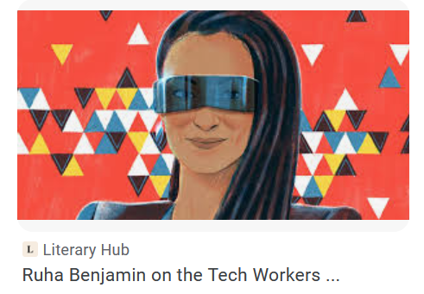
What are the human roles in “Artificial Intelligence (AI)”?
computer
robot?
tech?
machine?
algorithm/data
training/testing
“learning” / adapting
interacting

Slide 46

Humans are more involved in AI than many realize.
Large language models like Chat-GPT, image detection, pattern recognition, translation and other algorithms require large correctly labeled datasets.
algorithm/data
training/testing
“learning” / adapting
interacting
https://www.theverge.com/features/23764584/ai-artificial-intelligence-data-notation-labor-scale-surge-remotasks-openai-chatbots

Slide 47
Future of work involves human-machine teaming.
QUESTIONS YOU MIGHT CONSIDER WITH YOUR STUDENTS:
To what extent and when should AI mimic ways humans solve problems and interact?
Will AI create ways of doing things more cheaply in ways that humans will accept/use?
What policies or laws could help prevent harm in the creation and use of AI?
What is the problem that the creators of AI are trying to solve?
Who will be well-served by the answers that AI delivers?
What will be the human “AI durable” jobs of the future?

Slide 48
There has been a lot of buzz about AI with the recent Chat-GPT release.

Slide 49

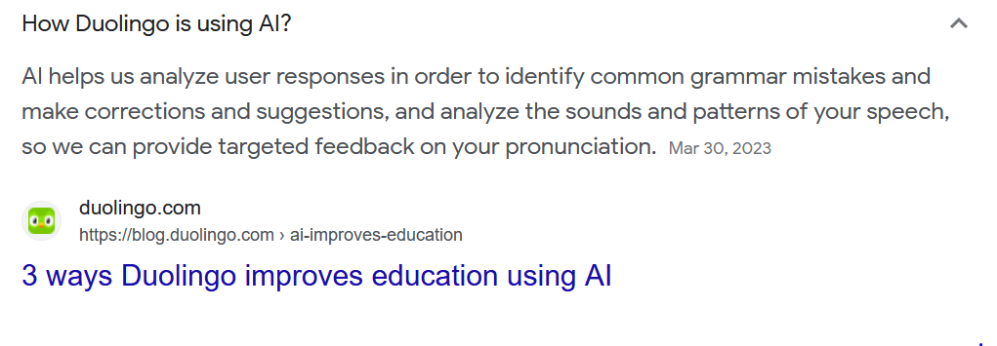
“Powered by AI” – means many things.
https://blog.duolingo.com/ai-improves-education/

Slide 50
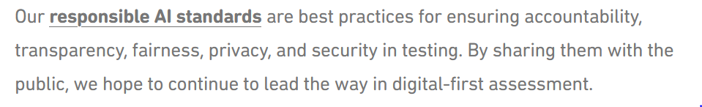
“Powered by AI” – means many things.
https://blog.duolingo.com/ai-improves-education/

Slide 51
These standards point to concerns about AI
Accountability – can you challenge results? Who is responsible for failures?
Transparency – do you know what data were used and how?
Fairness – who does the solution serve? who generated the data?
Privacy – who owns and has access to the data and results?
Security – are the data and results safe from leaks and hacks?
https://blog.duolingo.com/ai-improves-education/

Slide 52
Let’s compare the models of modeling
Traditional Math / Stats modeling
Formulate question/hypothesis
Gather data relevant to the problem
Build model, generate solution
Test model and iterate
Communicate results

Slide 53
Data science is big umbrella that can include traditional modeling, but sometimes is quite different.
Traditional Math / Stats modeling
Formulate question/hypothesis
Gather data relevant to the problem
Build model, generate solution
Test model and iterate
Communicate results
Some Current Data Science / AI
Large data sets (can be black box)
Ask question
Build/choose model(s)/algorithm(s) (sometimes details are secret)
Generate and iterate solutions (sometimes in black box)
Assess output (can be hard to test)
Communicate results

Slide 54
Solutions are fairly impossible to test or challenge if you don’t know what is in the box or how it works.
ASK A QUESTION
GET A
RECOMMENDATION
DATA
MODEL
ALGORITHM
PARAMETERS

Slide 55
Solutions are fairly impossible to test or challenge if you don’t know what is in the box or how it works.
ASK A QUESTION
GET A
RECOMMENDATION
DATA
MODEL
ALGORITHM
PARAMETERS
We need to develop policies and laws that require transparency.

Slide 56
What data science future are you excited about?
Individualized, meaningful learning experiences.
Automating jobs that are harmful to humans.
Personalized medicine.
Aiding scientific exploration and discovery.
Language learning and translation.
Addressing environmental and health issues.
In general, finding solutions to important problems to build a better future.

Slide 57
Together, we are going to grow data science education.

Slide 58




I hope we will keep in touch. Thank you! Rachel Levy (Ray) web: datascienceacademy.ncsu.edu email: datascienceacademy@ncsu.edu
Follow Us: @NCStateDSA

